Slide 1
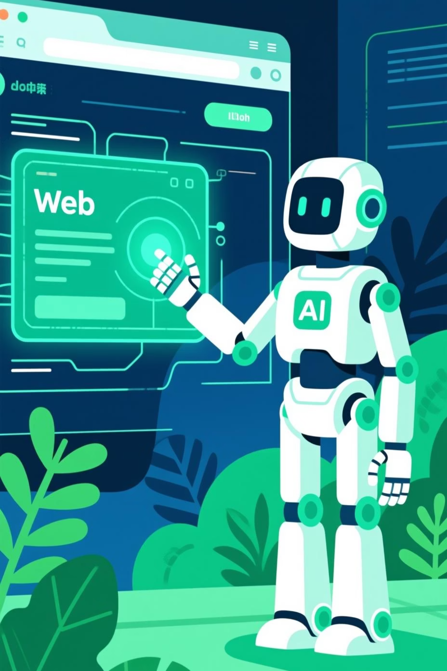
Browser Automation AI Agent
An intelligent, self-healing system that transforms natural language goals into automated browser tests—reducing manual debugging and maintenance while adapting to UI changes.

Slide 2
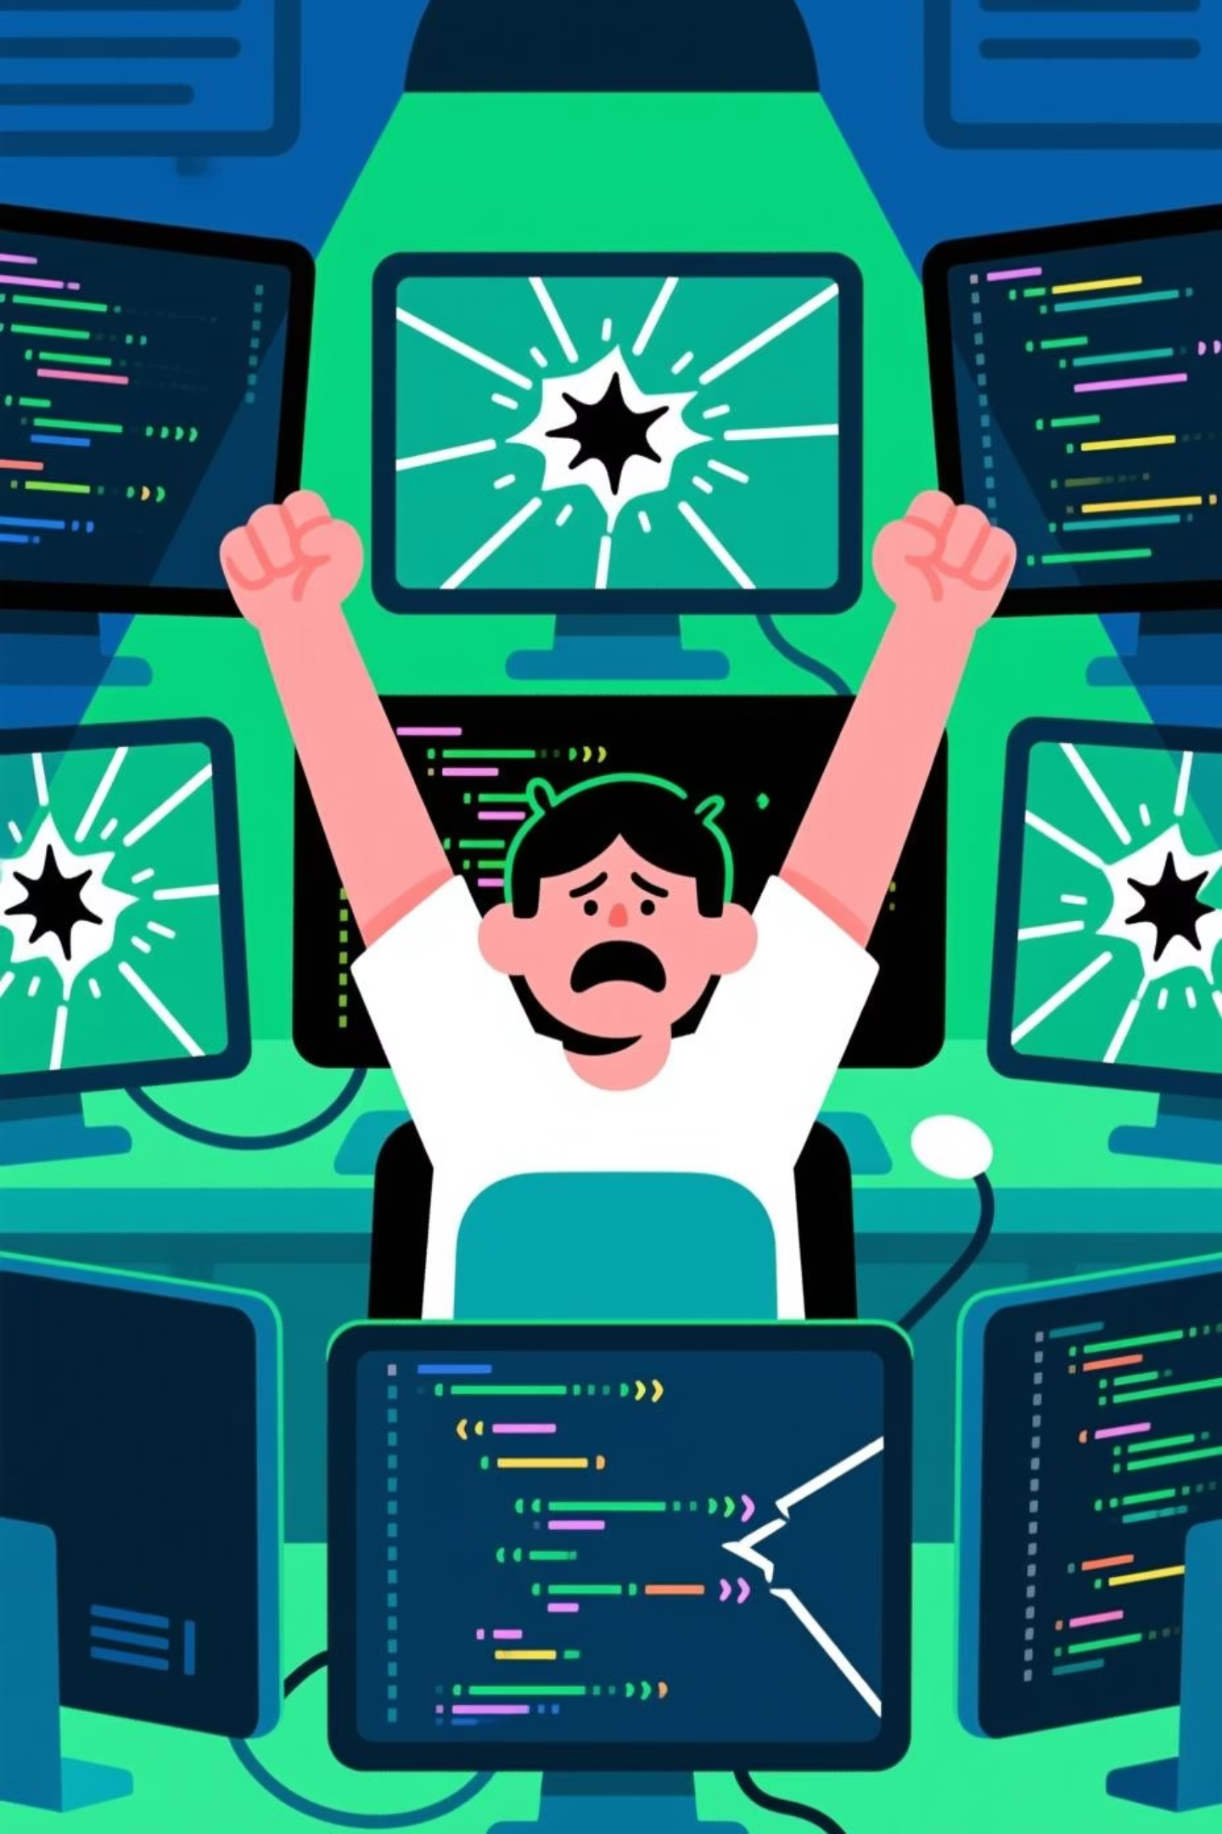
The Challenge with Traditional Browser Testing
❌ Manual Creation
❌ Fragile Tests
❌ High Maintenance
Writing test scripts is time-consuming and requires deep technical knowledge of selectors and page structure.
UI changes break tests frequently, causing false failures and maintenance overhead.
Constant script updates drain resources and slow down development cycles.
Our Solution
An AI-powered system that discovers user journeys, generates Playwright scripts, executes tests, diagnoses failures, and repairs itself automatically—turning browser automation into an intelligent, self-healing ecosystem.

Slide 3
How It Works: The AI Agent Architecture
0
Flow Discovery Agent
0
Script Generator Agent
Interprets natural language goals and maps them to concrete user actions like login, signup, or checkout flows.
Converts discovered steps into maintainable Playwright code following best practices and automation standards.
0
Execution
Agent
0
Error Diagnosis Agent
Runs generated scripts, captures screenshots, records videos, and logs execution details for comprehensive monitoring.
Analyzes failed runs to identify root causes—broken selectors, timeouts, or missing elements—with human-readable explanations.
0
Adaptive Repair Agent
0
Regression Monitor Agent
Implements self-healing strategies to fix common issues automatically and reruns scripts, maintaining test stability over time.
Tracks visual changes, detects UI regressions, and ensures visual consistency across test runs.

Slide 4
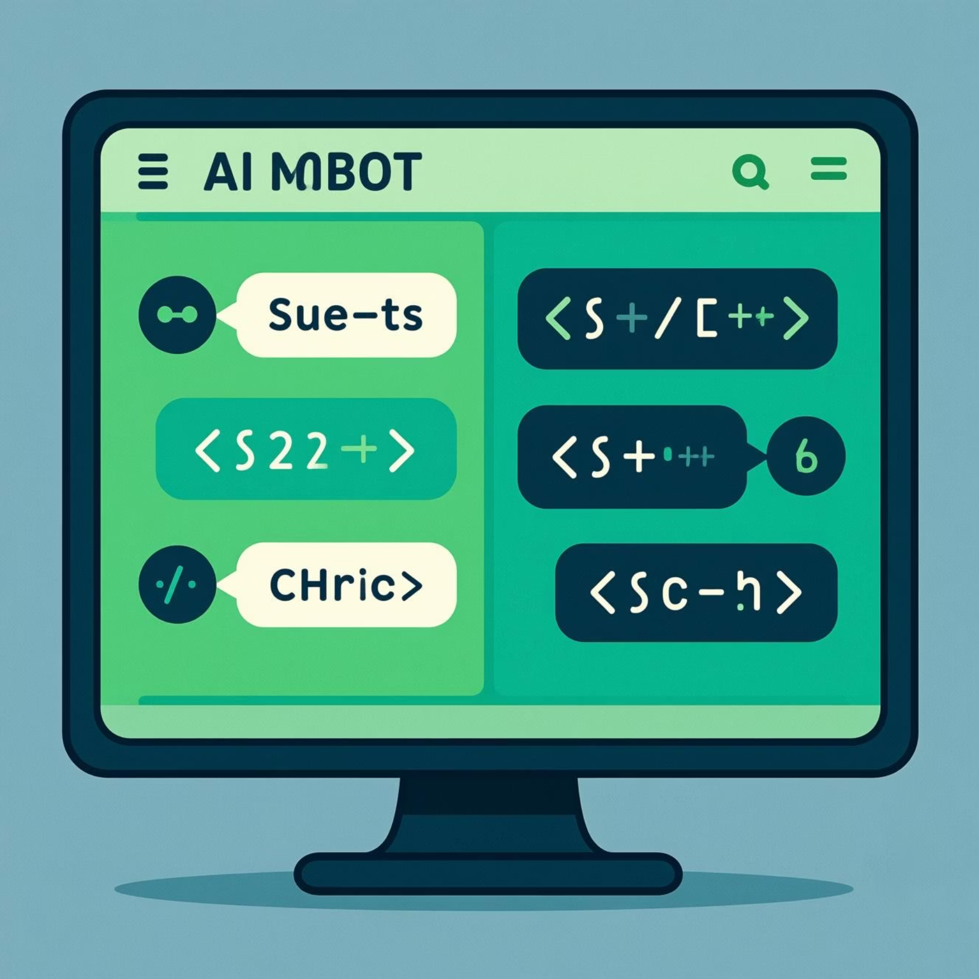
Technical Stack & Components
Core Technologies
🤖 AI Chatbot Assistant
Python 3.7+
Primary development language powering all agent logic and orchestration.
LangGraph Framework
Language based applications, focusing on creating and managing workflows.
Anthropic/ Claude-3.5-sonnet
AI layer for code generation, natural language understanding, and intelligent reasoning.
Playwright
Modern automation framework for reliable, cross-browser testing with auto-waiting capabilities.
.
Streamlit
Interactive web interface for easy test creation, execution monitoring, and chatbot assistance.
An intelligent assistant integrated directly into the platform that provides:
Real-time test planning guidance
Debugging support and error explanations
Web search capabilities for test scenarios
Context-aware recommendations

Slide 5
Key Benefits & Use Cases
Automated Testing
UI Regression Testing
User Flow Validation
CI/CD Integration
Generate and run comprehensive test suites for web applications without manual scripting effort.
Detect visual changes and layout regressions automatically, ensuring consistent user experience.
Validate critical user journeys like checkout, signup, and authentication flows continuously.
Seamlessly integrate self-healing tests into continuous integration pipelines for rapid feedback.
Why It Matters: This system transforms brittle, maintenance-heavy test scripts into an intelligent, adaptive automation framework—reducing QA costs while improving test coverage and reliability.

Slide 6

Exceptional Team Effort
Kudos to Our Outstanding Contributors
Chandra Sekhar Yandra
Georgy Pulivilayil James
Pramod Bhagat
Nitesh Sharma
Rajkumar Vaitheeswaran
Rashmi Iyer
Sabitha P.U.
This project exemplifies true collaboration, technical excellence, and innovative problem-solving. Each team member brought unique expertise and dedication that made this intelligent automation system possible.

Slide 7

Thank You !!
Special Thanks To:
Your passion for innovation and commitment to pushing technological boundaries has been truly inspiring. Together, we're building the future of intelligent browser automation.
The Outskill Team
Karthik, Shyam, and our invaluable mentors for their guidance, support, and technical leadership.
Global Cohorts
Innovators from around the world whose creativity, enthusiasm, and capabilities inspired and motivated us throughout this journey.
Let's continue innovating! 🚀

